Slide 1


MASTER THESIS
OPTIMISATION ON PATH PLANNING
& TRACKING ALGORITHM
FIRST REVIEW
GUIDE NAME : Dr. K GANESAN
STUDENT NAME: SUNIL L

Slide 2
ABSTRACT
Autonomous and semi-autonomous vehicle are becoming the fore coming of automotive. Simultaneous localization and mapping is one of the standing problems in the autonomous field. VSLAM is an emerging new feature, which works to identify the immediate area and can mapped to a projected surface. The SLAM is achieved by applying numerous interactions of matrices to have an accurate result. This mainly chains the vehicle where and how its headed thus by keeping away from running out of the track it is supposed to move.
SLAM and VSLAM both uses djikstra’s algorithm for path planning but due to its area searching inefficiency, furthermore optimisation have to be done. ASTAR is another type of algorithm which is predecessor of djikstra’s but it also has some limitation due to its computation. Optimisation in a way to reduce the computation time and resources.
KEY WORDS: SFM,RTAB,LOOP CLOSURE,ORB2,ROS-2D

Slide 3
LITERATURE SURVEY
3
MAPPING PAPERS
S.NO | YEAR | PAPER PUBLISHED | LITERATURE STUDY
1 | 2020 | A Remote RGB-D VSLAM Solution for Low Computational Powered Robots IEEE -(ICARSC) | Run/Variable Length (RVL) (a 16-bit depth image compression method). ORB SLAM 2 DECODE. Significant Delta values to assign 3 groups of 8 base coded. Cost effective by neglecting hardware interfaces.
2 | 2019 | Mobile robot V-SLAM based on improved closed loop detection algorithm IEEE -(ITAIC) | Pre by EKF and parallel tracking and mapping now by ORB2 with RANSAC. Characteristics match by FLANN(Fast Lib Approx. neighbor nest). 2 frames adjacent calculated FLANN effectively calculated effective match and eliminate error matching with RANSAC.
3 | 2019 | Initial RTAB-Map Navigation Analysis for Service Robot 5th International Conference on New Media Studies, Bali | Effective usage of RTAB map for RGB-D SLAM. It also uses RANSAC. Also describes various steps for memory allocation and retrieving. Finalizing graph method.

Slide 4
LITERATURE SURVEY
MAPPING PAPERS
S.NO | YEAR | PAPER PUBLISHED | LITERATURE STUDY
4 | 2019 | Robust Loop-Closure Detection with a Learned Illumination Invariant Representation for Robot Vslam IEEE (ICARM) | Main database runs on CNN based LIFT(Learned Invariant Feature Transform). Loop closure using BoW(bag of words) The native LIFT features 128 dimensions, we reduced the dimension to 64 dimensions by PCA method considering the real-time performance.
5 | 2017 | A Brief Review of Simultaneous Localization and Mapping School of Automation, Hangzhou Dianzi University, Hangzhou, China. | RTAB map and loop closure done by SLAM. Done by filter and graph optimization methods. Rao-Blackwellized Particle Filter (RBPF). reduces the dimension of the estimation by decomposing the state space of the Bayesian filter integrates to FASTSLAM.
6 | 2017 | Research on loop-closure detection in SLAM based on RGB-D camera Beijing Research Institute of Precise Mechatronics | Get the shortest path between poses by Dijikstra shortest path method SIFT algorithm will keep scale and rotation of feature vector invariance. Normal Distribution Transform algorithm (NDT). The NDT algorithm solves the minimum error through optimization iteration and adding the point clouds based on the relative position.

Slide 5
LITERATURE SURVEY
PATH PLANNING PAPERS
S.NO | YEAR | PAPER PUBLISHED | LITERATURE STUDY
7 | 2010 | Improvement of Dijkstra’s Algorithm and Its Application in Route Planning FSDK 2010. | Improvement in storage structure. Nodes to 2d structure formation. Time complexity improved by reducing redundancy. Implementation of restricted searching area.
8 | 2018 | Best routes selection using dijkstra and Floyd wall algorithm ICTS | Paper considers as djikstra’s algorithm as fast traveling time calculator. Floyd wall algorithm determines the minimal distance between two points. Together speeds up progressing time as well as reducing decision-making that does not lead to solution.
9 | 2019 | An Improved Dijkstra’s Algorithm for Shortest Path Planning on 2D Grid Maps IEEE | Discussion of various algorithms. IDA assigned as priority queue. 2D eight-neighbor grid map and describes IDA which can speed up the original Dijkstra’s algorithm by several orders of magnitude and introduces the usage with the A* algorithm for partially-known environments.

Slide 6
SCOPE
6
OPTIMISING THE DJIKSTRA’S ALGORITHM
Inefficiency is computation time and utilization of the available resources.
While planning a path usually djikstra’s algorithm surfs entire surface and this leads to computation time and latency in identifying the shortest path.
Sources must be collected in stringent quantities such that computation time is reduced.
These can be rectified by altering the fundamental elements such as significant delta values and iterations processed with given resources is reduced without latency in attaining the shortest path.

Slide 7
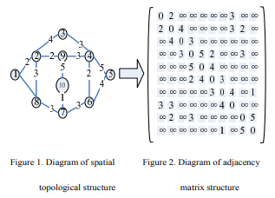
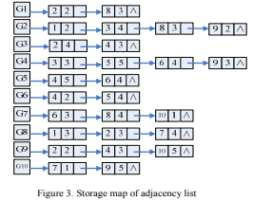

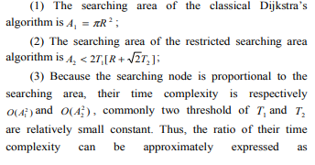
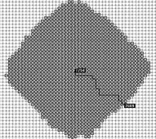
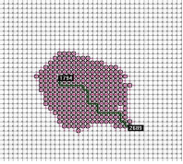
SCOPE MATHEMATICAL MODELING
7
CLASSICAL DIJKSTRA
RESTRICTED SEARCH AREA DIJKSTRA

Slide 8
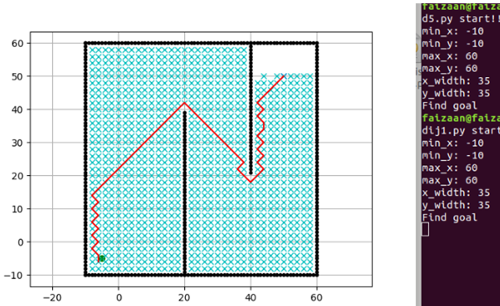
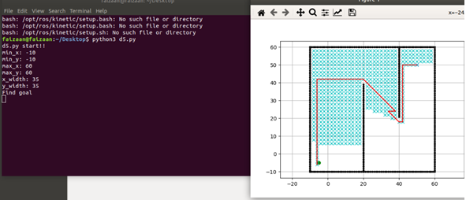
OPTIMIZED DIJKSTRA OUTPUT
CLASSICAL DIJKSTRA OUTPUT
OPTIMIZED DIJKSTRA OUTPUT

Slide 9
PSUDO-CODE
10
ALGORITHM FLOW
Import Raspberry-gpio-python as general purpose input/output module.
Allocating the PINS and assigning the values.
Declaring the functions .
Defining the parameters for functions.
Calling the functions.
MOTOR FUNCTION LOGIC
If function is called via assigned number it triggers specific function declaration.
Forward and reverse direction are assigned as motor 1A, 1B depends upon input current flows into the motor in specific direction and vice versa
Steering directions motor are assigned as motor 2A, 2B depends upon the input current flows into the motor in specific direction and vice versa.
E- enable pin for activating the particular unit.
Adding delay after executing.

Slide 10
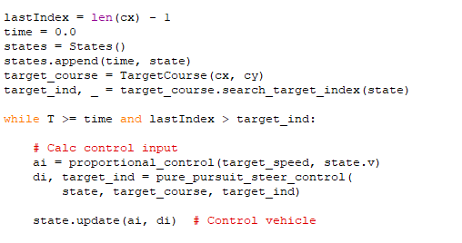
PURE PURSUIT
AREA UPDATION IN PURE PURSUIT
Pure pursuit allows the object to be tracked on given sample points which are varying in continuous look ahead distances.
The main use of pure pursuit is to allows the data to flow from the source to destination and making the following path very linearly.
I’ve altered in such a way that it tracks within a certain range of boundaries.
Programmed is pre burnt into the raspberry pi while execution of the tracking module

Slide 11
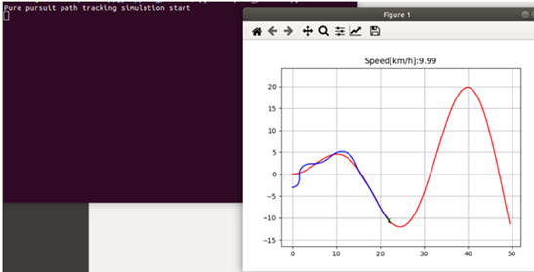
PURE-PURSUIT TRACKING FXN
At given point with respect to time the tracking algorithm tracks while it maintain in the line of reference.
After executing the planning algorithm the tracking algorithm is said to be imported into it for performing tracking process.
This image depicts the follower point to stay in line of reference while reaching the destination.
At a certain point Q stable point with speed is also been recorded for deviation purposes from the set of conditions that should satisfy the stringent values.

Slide 12
SENSORS
IMU
This sensor particularly used for angle extraction from given points on a dimension.
So we made few alternations in our program so that it can say while it gets hit for every 3ft distance
And the updation is done by hall effect to bring out the exact timing when it gets hit
At the time of hit the latitude and longitude of the given surface projection are estimated.
HALL EFFECT
A simple but critical component that regulates the flow of data which is been sent for estimating the coordinates.
It determines the rate at which the sampling has to been taken, i.e. per rotation 3ft such that distance is measured when it get hits in.
Further a step more correcting its accuracy can yield better predictions.
Further more optimization on IMU linked with HALL has to be done to get near accurate predictions.

Slide 13
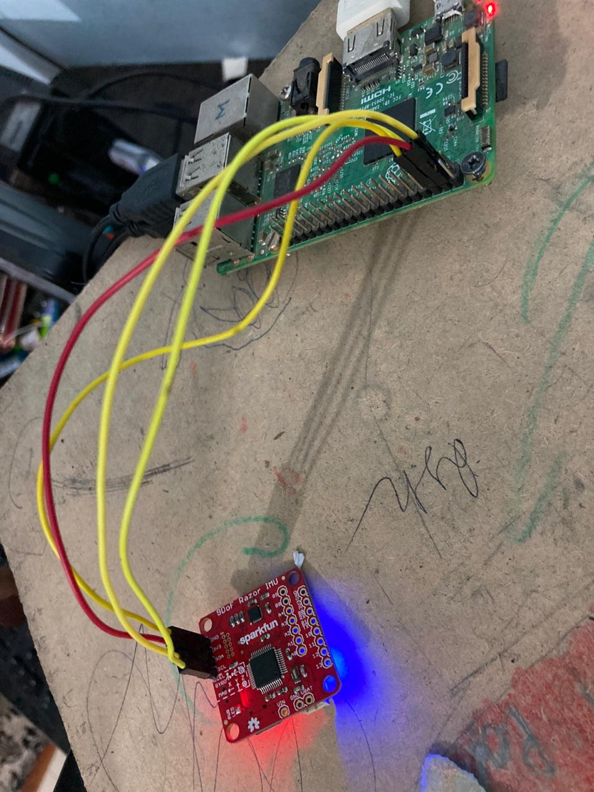
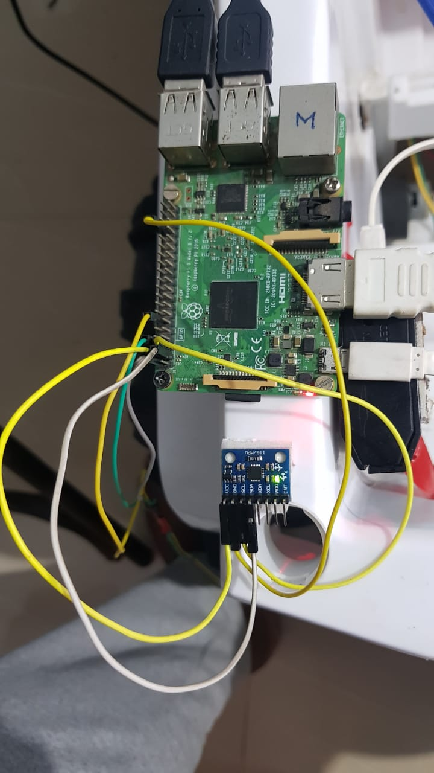
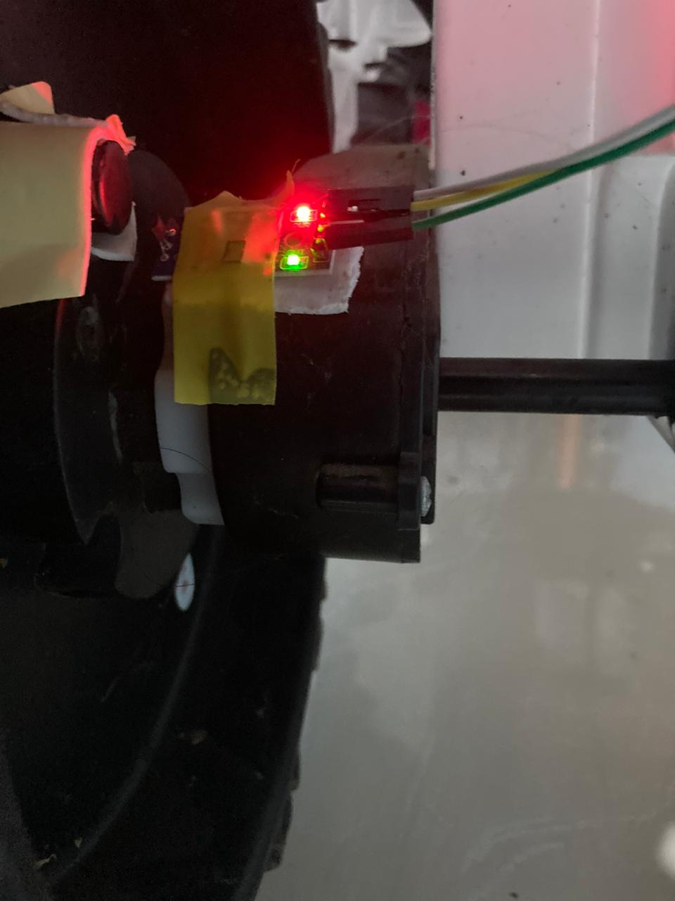
IMU SENSOR
HALL SENSOR
N-N POLE FACING MAGNETS
MP9250 IMU SENSOR
HALL EFFECT SENSOR
PRIMORDIAL IMU SENSOR

Slide 14
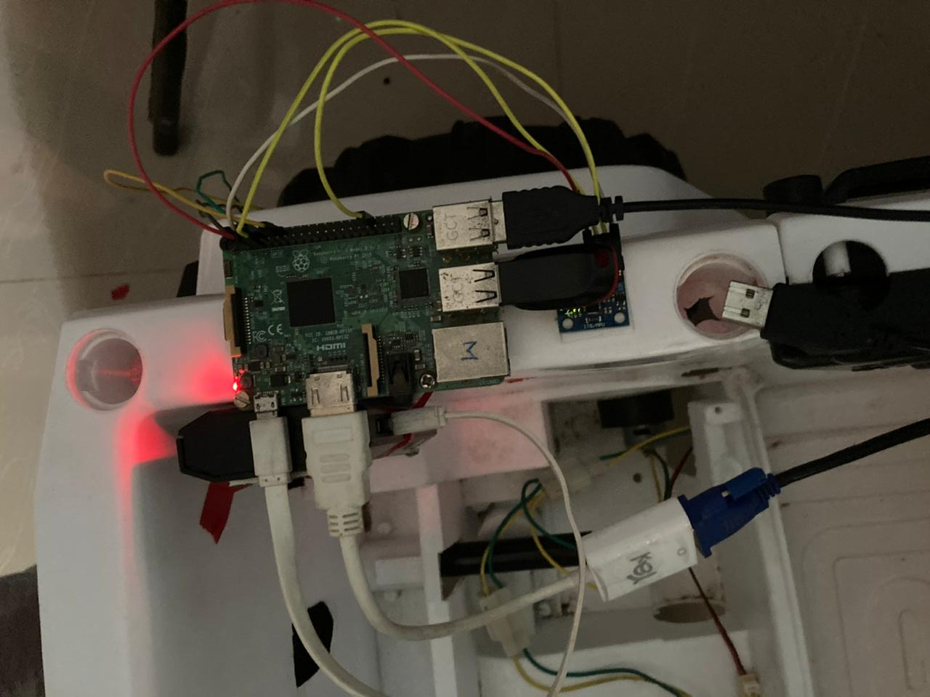
TRACKING MODULE
RASPBERRY PI MODULE
HALL EFFECT SENSOR
IMU SENSOR-2
POWER UNT
MONITOR
POLYGON FXN
HALL SENSOR
IMU
RASPBERRY PI
POWER UNIT
HDMI TO MONITOR

Slide 15
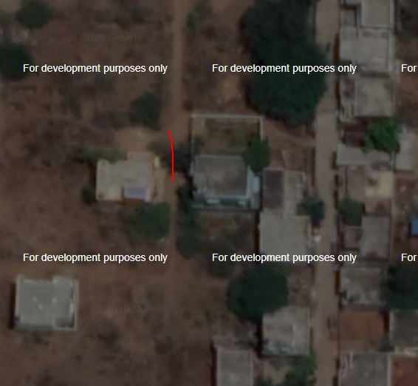
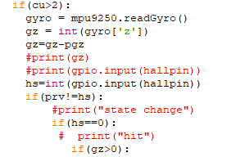
TRACKING MODULE
HALL-IMU DATA HITS
LATITUDE AND LONGITUDE ESTIMATION
ESTIMATION ON COORDINATES

Slide 16
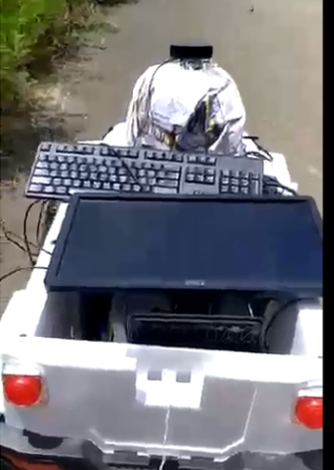
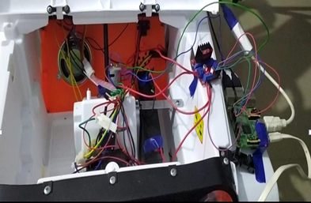
HARDWARE SETUP
8
MODULES WITH GPU
MODULES INTERCONNECTED

Slide 17
CONCLUSION
FUTURE WORKS
We developed a prototype that can manipulate data that flows from the given three modules and renders an output to desired condition.
The main objective of this project is to design and develop an autonomous robot or vehicles that can steer to the desired location once the values are been rendered.
At this part of the stage the vehicles can manipulate to some extent and it got it output at the initial stages. The prototype can able to receive the data wirelessly and process the iterations for given specification of coordinates.
Data interpretation between the module of steering has been enhanced to better condition that it can manipulate data that flows via it.
FUTURE WORKS
The prototype should manipulate the data that arises from the obstruction modules as well.
Path planning and tracking algorithms are to be enhanced to maximum output wirelessly.
Target acquisition and path planning and selecting en route are to be maximized and enhanced.
Based on the geographical conditions these are to be developed for Indian road for better customization.
The practicality of this prototype for Indian roads are been continuously challenged by various factors that interrupts the training to inhibit.
Better functionality code and algorithm for the modules are yet to be processed.
Autonomous vehicles initiation bigger challenge is how the training has to be done with given storage and computational power, this has to been over seen.

Slide 18
REFERENCES
(Best Routes Selection Using Dijkstra & Floyd-Warshall Algorithm-2017)-Risald et al.,
(Improvement of Dijkstra Algorithm and its application in Route Planning)-Dong Kai et al.,
(Analysis of QOS VLAN based on Dijkstra Algorithm on OSPF)-M. Nurr Alfarni et al.,
(An Improved Dijkstra’s Algorithm for Shortest Planning on 2-D)-Li Wenzheng et al.,
(Design of a Modified Dijkstra;s Algorithm for finding Alternate Routes for Shortest-Path Problems with Huge Costs)-Omoniyi et al.,
(Novel Pure-Pursuit Trajectory Following Approaches & their Practical Applications)-Erno Horvath et al.,
(Path tracking Control of Wheeled Mobile robot based on Improved Pure -Pursuit Algorithm)-Sun Quinpeng et al.,
(Towards Shortest Path Computation using Dijkstra’s Algorithm-2020)- Neha et al.,
(Shortest Path with Dynamic Weight Implementation using Dijkstra’s Algorithm-2018)-Aditiya et al.,
(Autonomous Indoor Vehicle Navigation using modified Steering Velocity Objects-2020)-M. Faud & Djoko et al.,

